Slide 1

Predicting Customer Churn in Telecom
This presentation explores the critical issue of customer churn in the telecom industry. We will delve into the importance of churn analysis, the methodology employed, and the key findings and recommendations for improving customer retention.
Rajmurthi KM | MBE 11

Slide 2
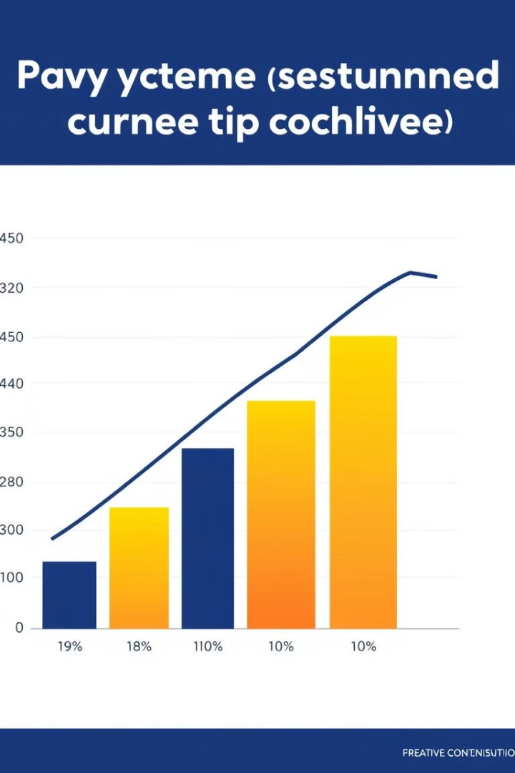
Introduction to Churn Analysis
Customer churn refers to customers ceasing to use a company's products or services. Analyzing churn is crucial for retaining profitable customers, improving service quality, and boosting long-term business growth.
1
Retain Profitable Customers
2
Improve Service Quality
Understanding churn drivers allows businesses to address customer pain points and enhance service quality.
Churn analysis helps identify and retain valuable customers who contribute significantly to revenue.
3
Boost Long-Term Business Growth
Reducing churn leads to increased customer lifetime value, driving sustainable business growth.

Slide 3

Objective 1 – Predict and Analyze Churn
The primary objective is to leverage analytics to identify high-risk customer segments and understand the factors contributing to churn.
1
Identify High-Risk Segments
Predictive models help identify customers with a high probability of churning, allowing for targeted retention efforts.
2
Understand Churn Drivers
Analyzing churn data reveals the key factors influencing customer decisions, providing insights for improvement.
3
Develop Predictive Models
Advanced analytics techniques are used to build predictive models that forecast churn likelihood and inform retention strategies.

Slide 4
Objective 2 – Provide Actionable Insights & Leverage Advanced Tools
The goal is to provide actionable insights that inform marketing strategies, service improvements, and customer retention initiatives.
Actionable Insights
Tools Used
Recommendations are tailored to address specific churn drivers and improve customer satisfaction.
Advanced tools are employed to analyze data and generate insights.
Marketing Strategies
SQL for database queries
Service Improvements
Power BI for interactive dashboards
Customer Retention Initiatives

Slide 5

Why Churn Analysis Matters – Retention and Revenue
Customer retention is a key driver of profitability, as retaining existing customers is significantly cheaper than acquiring new ones.
Customer Retention
Revenue Impact
Retaining existing customers is 5-7x cheaper than acquiring new ones, making retention a strategic priority.
Lower churn improves lifetime customer value, reduces marketing costs, and drives consistent revenue growth.

Slide 6



Why Churn Analysis Matters – Customer Insights
Understanding customer behavior is essential for tailoring services to their needs and improving satisfaction.
Understanding Customer Behavior
Personalization Benefits
Identifying churn patterns allows businesses to understand customer needs and preferences.
Customer insights enable businesses to design personalized experiences that boost satisfaction and loyalty.

Slide 7

Data Collection
Data is extracted from telecom databases, encompassing various fields related to customer demographics, account details, service usage, billing, and churn status.
Demographics
Age, gender, marital status
Account Details
Contract type, tenure, payment method
Service Usage
Internet, phone, streaming, security, backup
Billing
Monthly and total charges
Churn Status
Indicator of customer retention

Slide 8

Data Preprocessing
Data preprocessing is essential to ensure accurate and reliable analysis. This involves removing duplicates, handling missing values, normalizing numerical variables, and addressing outliers.
1
Remove Duplicates
2
Handle Missing Values
Duplicate records are removed to avoid bias and ensure data integrity.
Missing values are imputed using appropriate techniques to maintain data completeness.
3
Normalize Numerical Variables
4
Detect and Address Outliers
Numerical variables are normalized to ensure consistency and comparability across different scales.
Outliers are identified and addressed using statistical methods to avoid skewing analysis results.

Slide 9
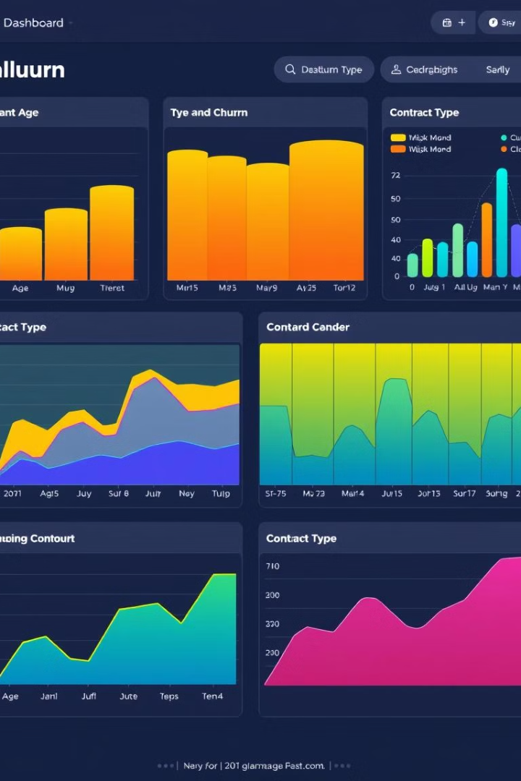



Exploratory Data Analysis
Exploratory data analysis reveals insights into churn trends by demographics, service usage patterns, and other key factors.
Trends in Churn
Analyzing churn rates by age, gender, and contract type reveals significant patterns.
Service Usage Patterns
Understanding how service usage impacts churn provides valuable insights for retention strategies.
Visualization
SQL queries and dashboards in Tableau/Power BI provide visual representations of key patterns and trends.

Slide 10

Feature Engineering
Feature engineering involves creating new features from existing data to enhance model accuracy and interpretability.
Tenure Categories
High-Charge Customers
Customers are categorized based on their tenure: Less than 6 months, 6–24 months, and More than 24 months.
Customers with monthly charges above $70 are identified as a high-risk segment.

Slide 11
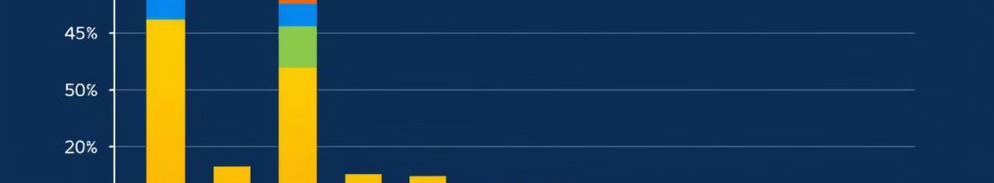
Key Findings – Demographics
1
Age-Related Churn
2
Gender Influence
3
Strategic Recommendations
Our analysis reveals that customers aged 30-50 exhibit the highest churn rate, indicating a potential vulnerability within this demographic.
While the overall churn rate is relatively similar across genders, females demonstrate a slightly higher churn tendency, suggesting a need to address specific needs and preferences.
Tailoring retention strategies to age-specific preferences and addressing gender-specific needs through personalized communications and targeted offers can significantly reduce churn within these demographics.

Slide 12
Key Findings – Contract Types
Monthly Contracts
Yearly Contracts
Strategic Recommendations
Our data shows a considerably higher churn rate of 42% among customers with monthly contracts, indicating a lack of commitment and higher propensity to switch providers.
Yearly contracts demonstrate a significantly lower churn rate of 11%, highlighting the importance of longer-term commitments in customer retention.
Incentivize customers to switch to longer-term contracts by offering attractive discounts, bundled services, or exclusive benefits. This shift towards longer commitments can significantly reduce churn over time.

Slide 13
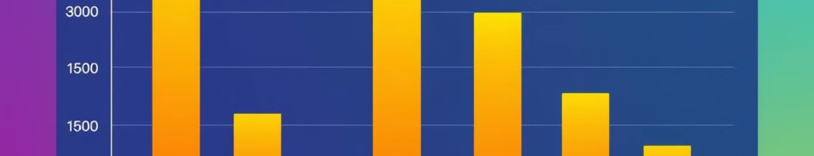
Key Findings – Service Usage
Streaming Services
Bundled Services
Strategic Recommendations
Streaming services alone exhibit a relatively high churn rate of 32%, indicating a need to enhance their value proposition or bundle them with other services.
Customers who opt for bundled services, including security and backup, have a significantly lower churn rate of 19%, demonstrating the effectiveness of offering value-added packages.
Promote bundled services to reduce churn risks by providing a greater sense of value and incentivizing customers to choose comprehensive service packages.

Slide 14



Key Findings – Charges Analysis
High Monthly Charges
Strategic Recommendations
Customers with monthly charges exceeding $70 demonstrate a high churn rate of 35%, indicating that price sensitivity plays a significant role in customer retention.
Introduce affordable pricing tiers or discounts for high-risk customers to address their price concerns and prevent churn due to high costs.

Slide 15
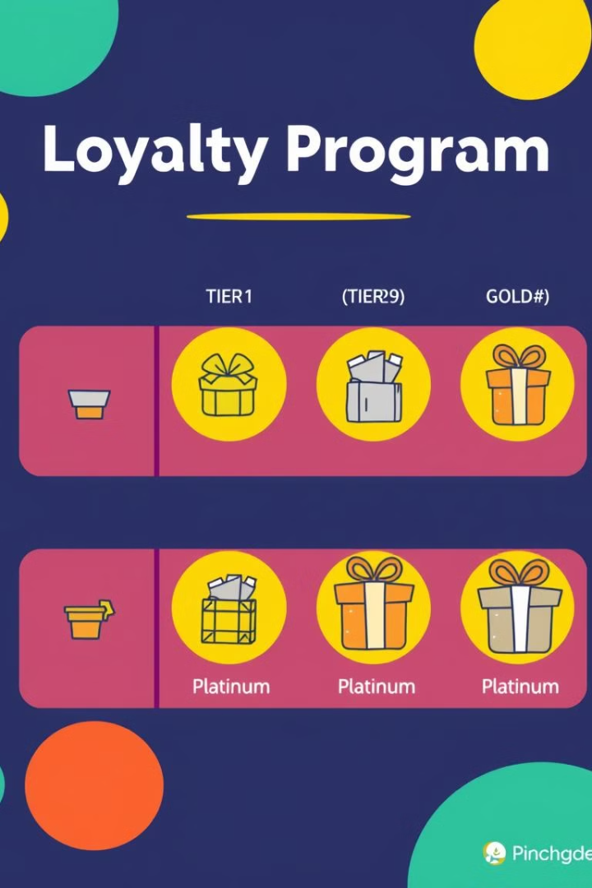
Loyalty Programs
Suggestion
Impact
Tiered rewards for long-term customers.
Recognizes customer loyalty and incentivizes continued patronage.
Cashback incentives for loyal customers.
Provides tangible rewards and encourages repeat purchases.
Exclusive benefits such as premium support or priority service.
Offers personalized experiences and enhances customer satisfaction.
Loyalty programs are crucial for fostering customer loyalty and reducing churn by offering tangible benefits and personalized experiences. They create a sense of value and strengthen customer relationships.

Slide 16



Targeted Offers
Personalized Discounts
Bundled Service Offers
Offer customized discounts to customers with high churn probability based on their individual profiles and service usage patterns.
Promote bundles based on usage patterns, such as combining streaming services with security and backup, to enhance value and reduce churn risks.
Targeted offers personalized to individual customer needs and preferences can effectively reduce churn by addressing specific pain points and incentivizing continued service usage.

Slide 17
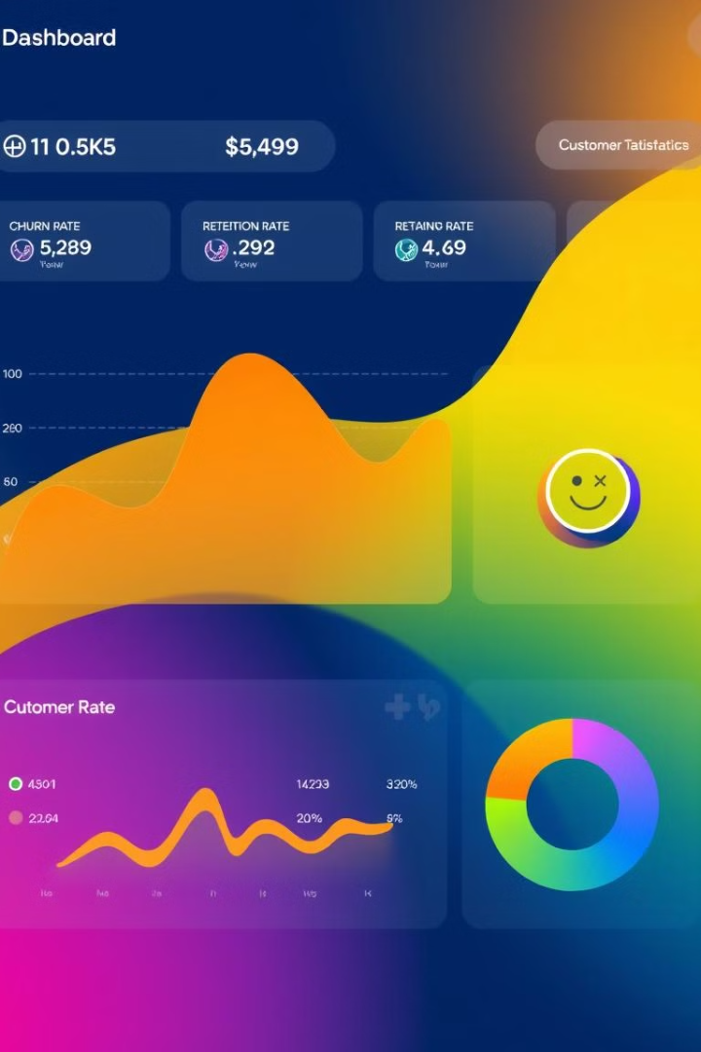
Monitoring and Refinement
Key Metrics (KPIs)
Purpose
Monthly churn rate
Tracks the overall churn rate and its fluctuations over time.
Retention percentage by segment
Identifies customer segments with higher or lower retention rates for targeted interventions.
Continuously monitoring key performance indicators (KPIs) and analyzing customer behavior is essential for proactively identifying churn risks and refining retention strategies. By analyzing data trends and adapting our approach, we can effectively mitigate churn and foster long-term customer relationships.

Slide 18

Recap of Key Findings
Age Group
1
Customers aged 30-50 exhibit high churn rates, indicating a need for age-specific retention strategies.
2
Contract Types
Monthly contracts show a significantly higher churn rate compared to yearly contracts, highlighting the importance of long-term commitments.
Service Usage
3
Streaming services alone have a high churn rate, while bundled services, including security and backup, effectively reduce churn.
4
Pricing
High monthly charges contribute to increased churn rates, emphasizing the importance of affordable pricing options.
By understanding the key findings and insights from the churn analysis, we can develop data-driven strategies to effectively address churn drivers and improve customer retention.

Slide 19
Action Plan
Short-Term Actions
Long-Term Goals
Implement loyalty programs to recognize and reward long-term customers.
Continuously refine churn prediction models and analyze new data to stay ahead of churn risks.
Offer targeted discounts to customers with high churn probability.
Strengthen customer relationships through personalized communications and targeted offers.
Promote bundled services to provide a greater sense of value and reduce churn risks.
This comprehensive action plan, encompassing both short-term initiatives and long-term objectives, will enable us to effectively address customer churn, improve retention rates, and foster lasting customer relationships.

Slide 20

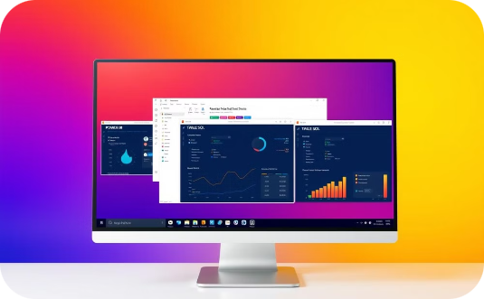
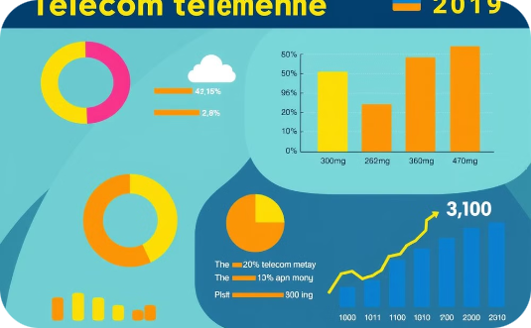
Appendix and References
Visuals
Tools
References
Detailed charts and heatmaps showcase churn rates by customer segments, including age, contract types, service usage, and pricing plans.
Data analysis and visualization tools utilized for the churn analysis include SQL, Power BI, and Tableau.
References include reputable telecom datasets and industry benchmarks, such as research reports, industry publications, and government statistics.

Slide 21
Thank You

